Slide 1



POWER BI PROJECT PORTFOLIO
FINANCE
View in Power BI
PRAGADEESWARAN S

Slide 2
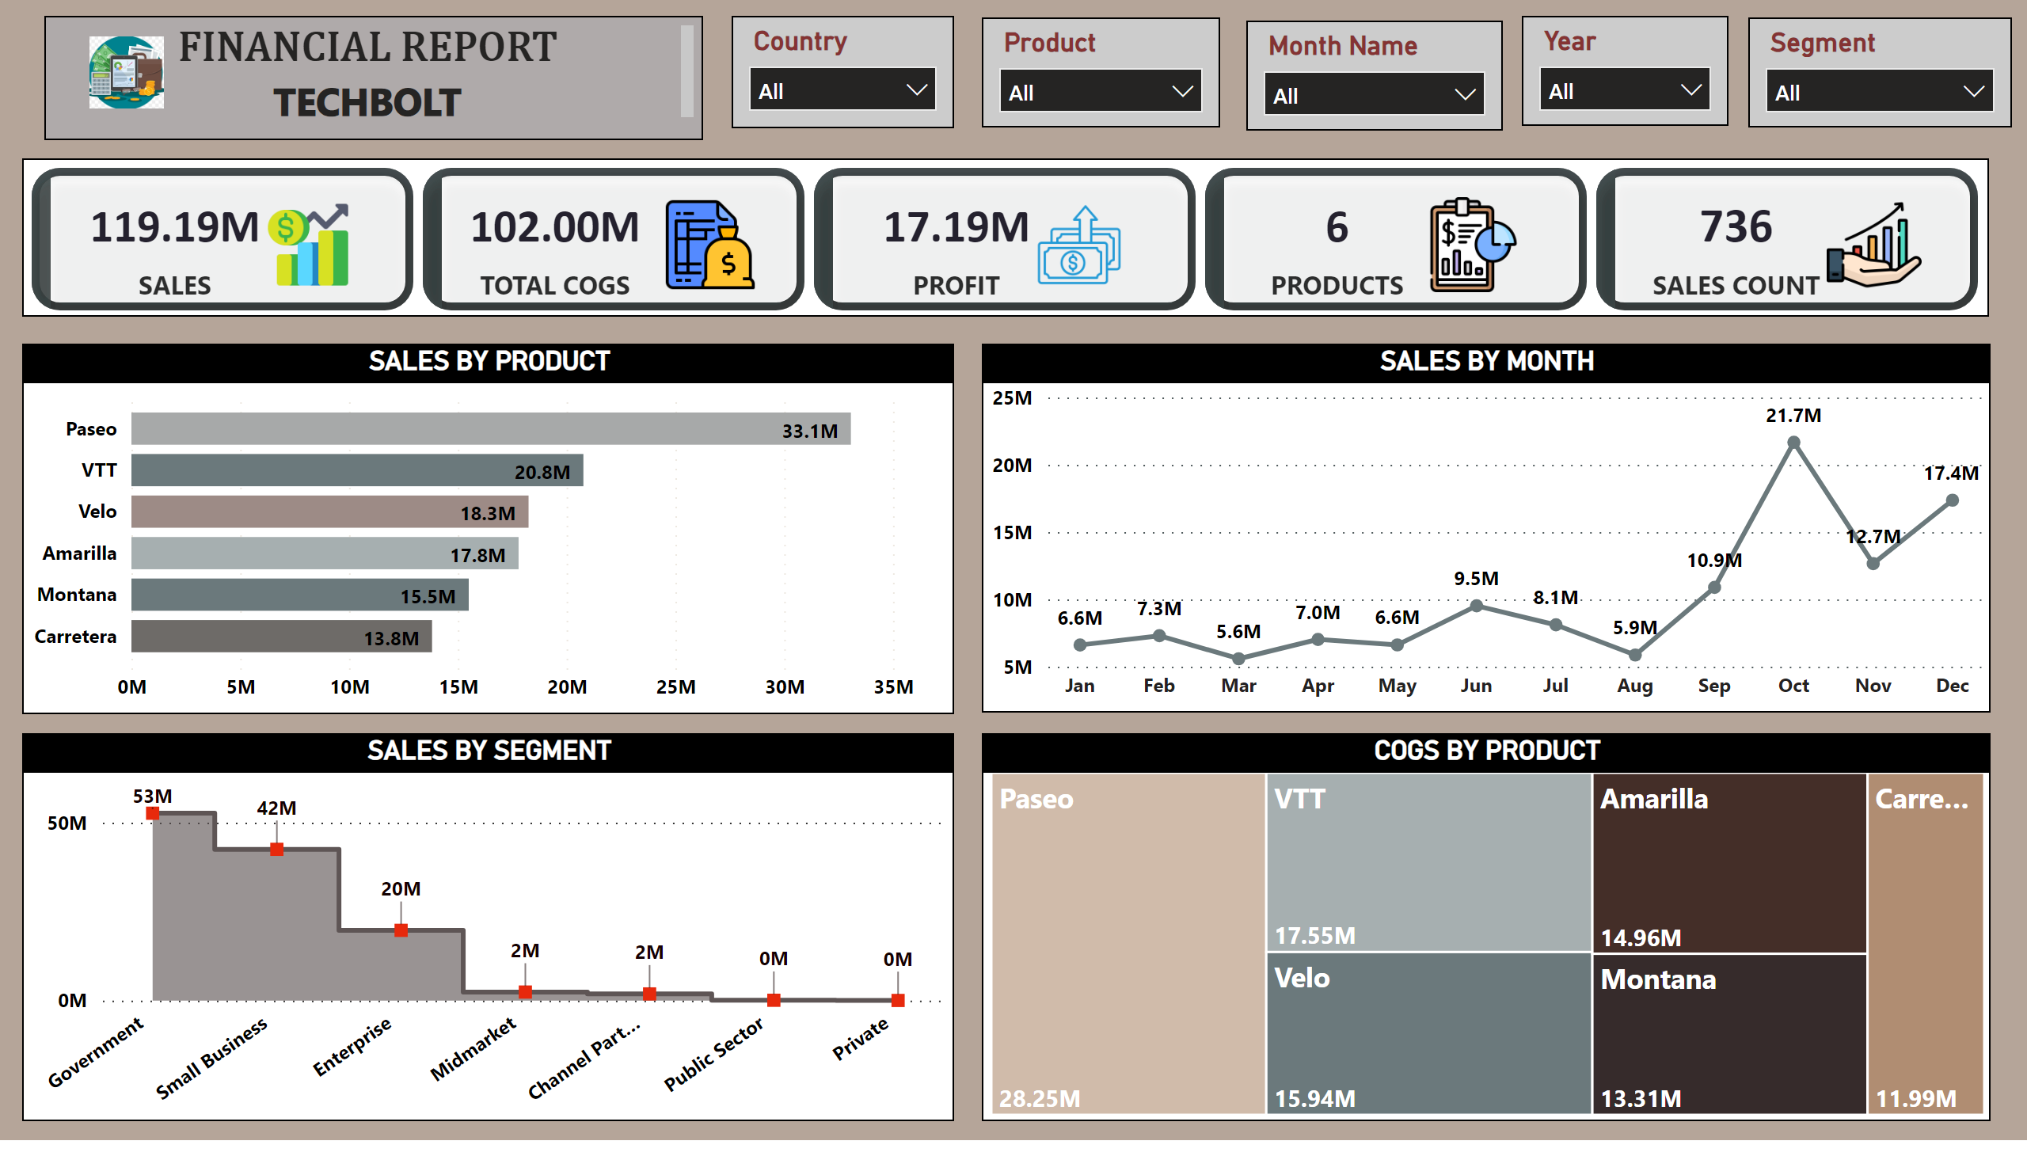
Page 1
Notes:
slicer
No alt text provided
COGS BY PRODUCT
No alt text provided
SALES BY PRODUCT
No alt text provided
SALES BY SEGMENT
No alt text provided
SALES BY MONTH
No alt text provided
slicer
No alt text provided
cardVisual
No alt text provided
textbox
No alt text provided
image
No alt text provided
slicer
No alt text provided
slicer
No alt text provided
slicer
No alt text provided

Slide 3
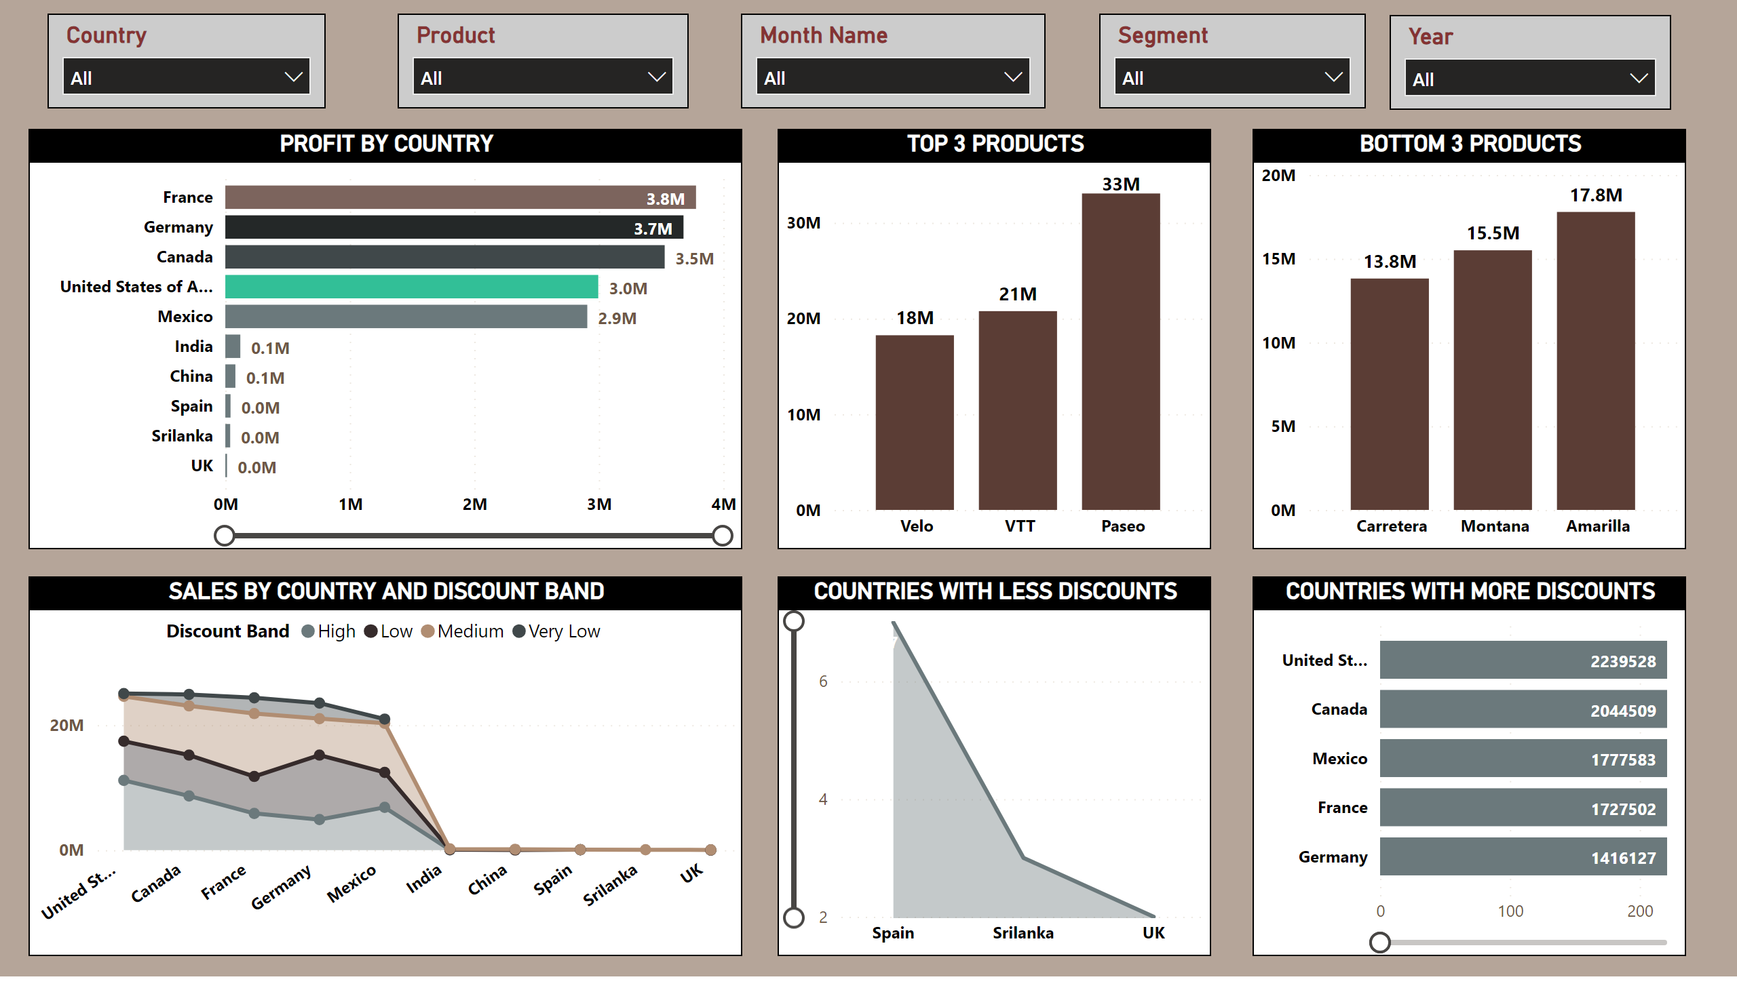
Page 2
Notes:
BOTTOM 3 PRODUCTS
No alt text provided
COUNTRIES WITH MORE DISCOUNTS
No alt text provided
PROFIT BY COUNTRY
No alt text provided
slicer
No alt text provided
SALES BY COUNTRY AND DISCOUNT BAND
No alt text provided
COUNTRIES WITH LESS DISCOUNTS
No alt text provided
TOP 3 PRODUCTS
No alt text provided
slicer
No alt text provided
slicer
No alt text provided
slicer
No alt text provided
slicer
No alt text provided
slicer
No alt text provided

Slide 4
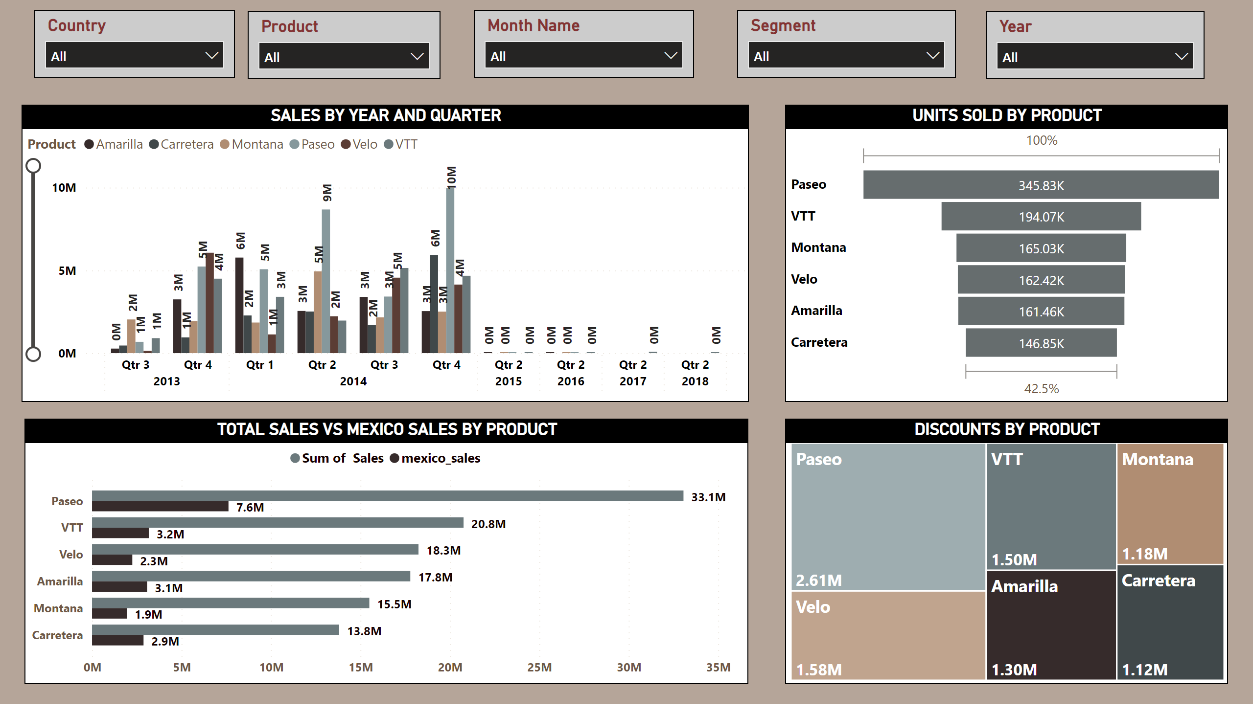
Page 3
Notes:
SALES BY YEAR AND QUARTER
No alt text provided
UNITS SOLD BY PRODUCT
No alt text provided
TOTAL SALES VS MEXICO SALES BY PRODUCT
No alt text provided
DISCOUNTS BY PRODUCT
No alt text provided
slicer
No alt text provided
slicer
No alt text provided
slicer
No alt text provided
slicer
No alt text provided
slicer
No alt text provided
slicer
No alt text provided

Slide 5
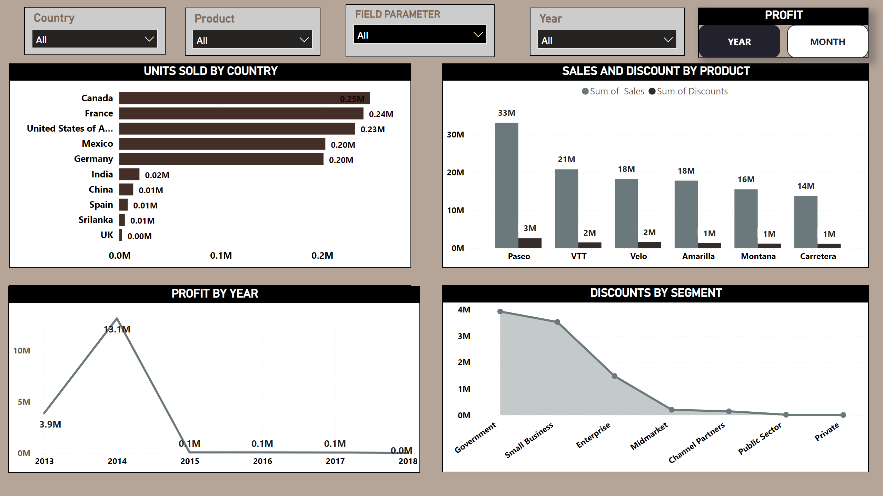
Page 4
Notes:
UNITS SOLD BY COUNTRY
No alt text provided
PROFIT BY MONTH
No alt text provided
DISCOUNTS BY SEGMENT
No alt text provided
SALES AND DISCOUNT BY PRODUCT
No alt text provided
slicer
No alt text provided
slicer
No alt text provided
slicer
No alt text provided
PROFIT BY YEAR
No alt text provided
PROFIT
No alt text provided
slicer
No alt text provided

Slide 6
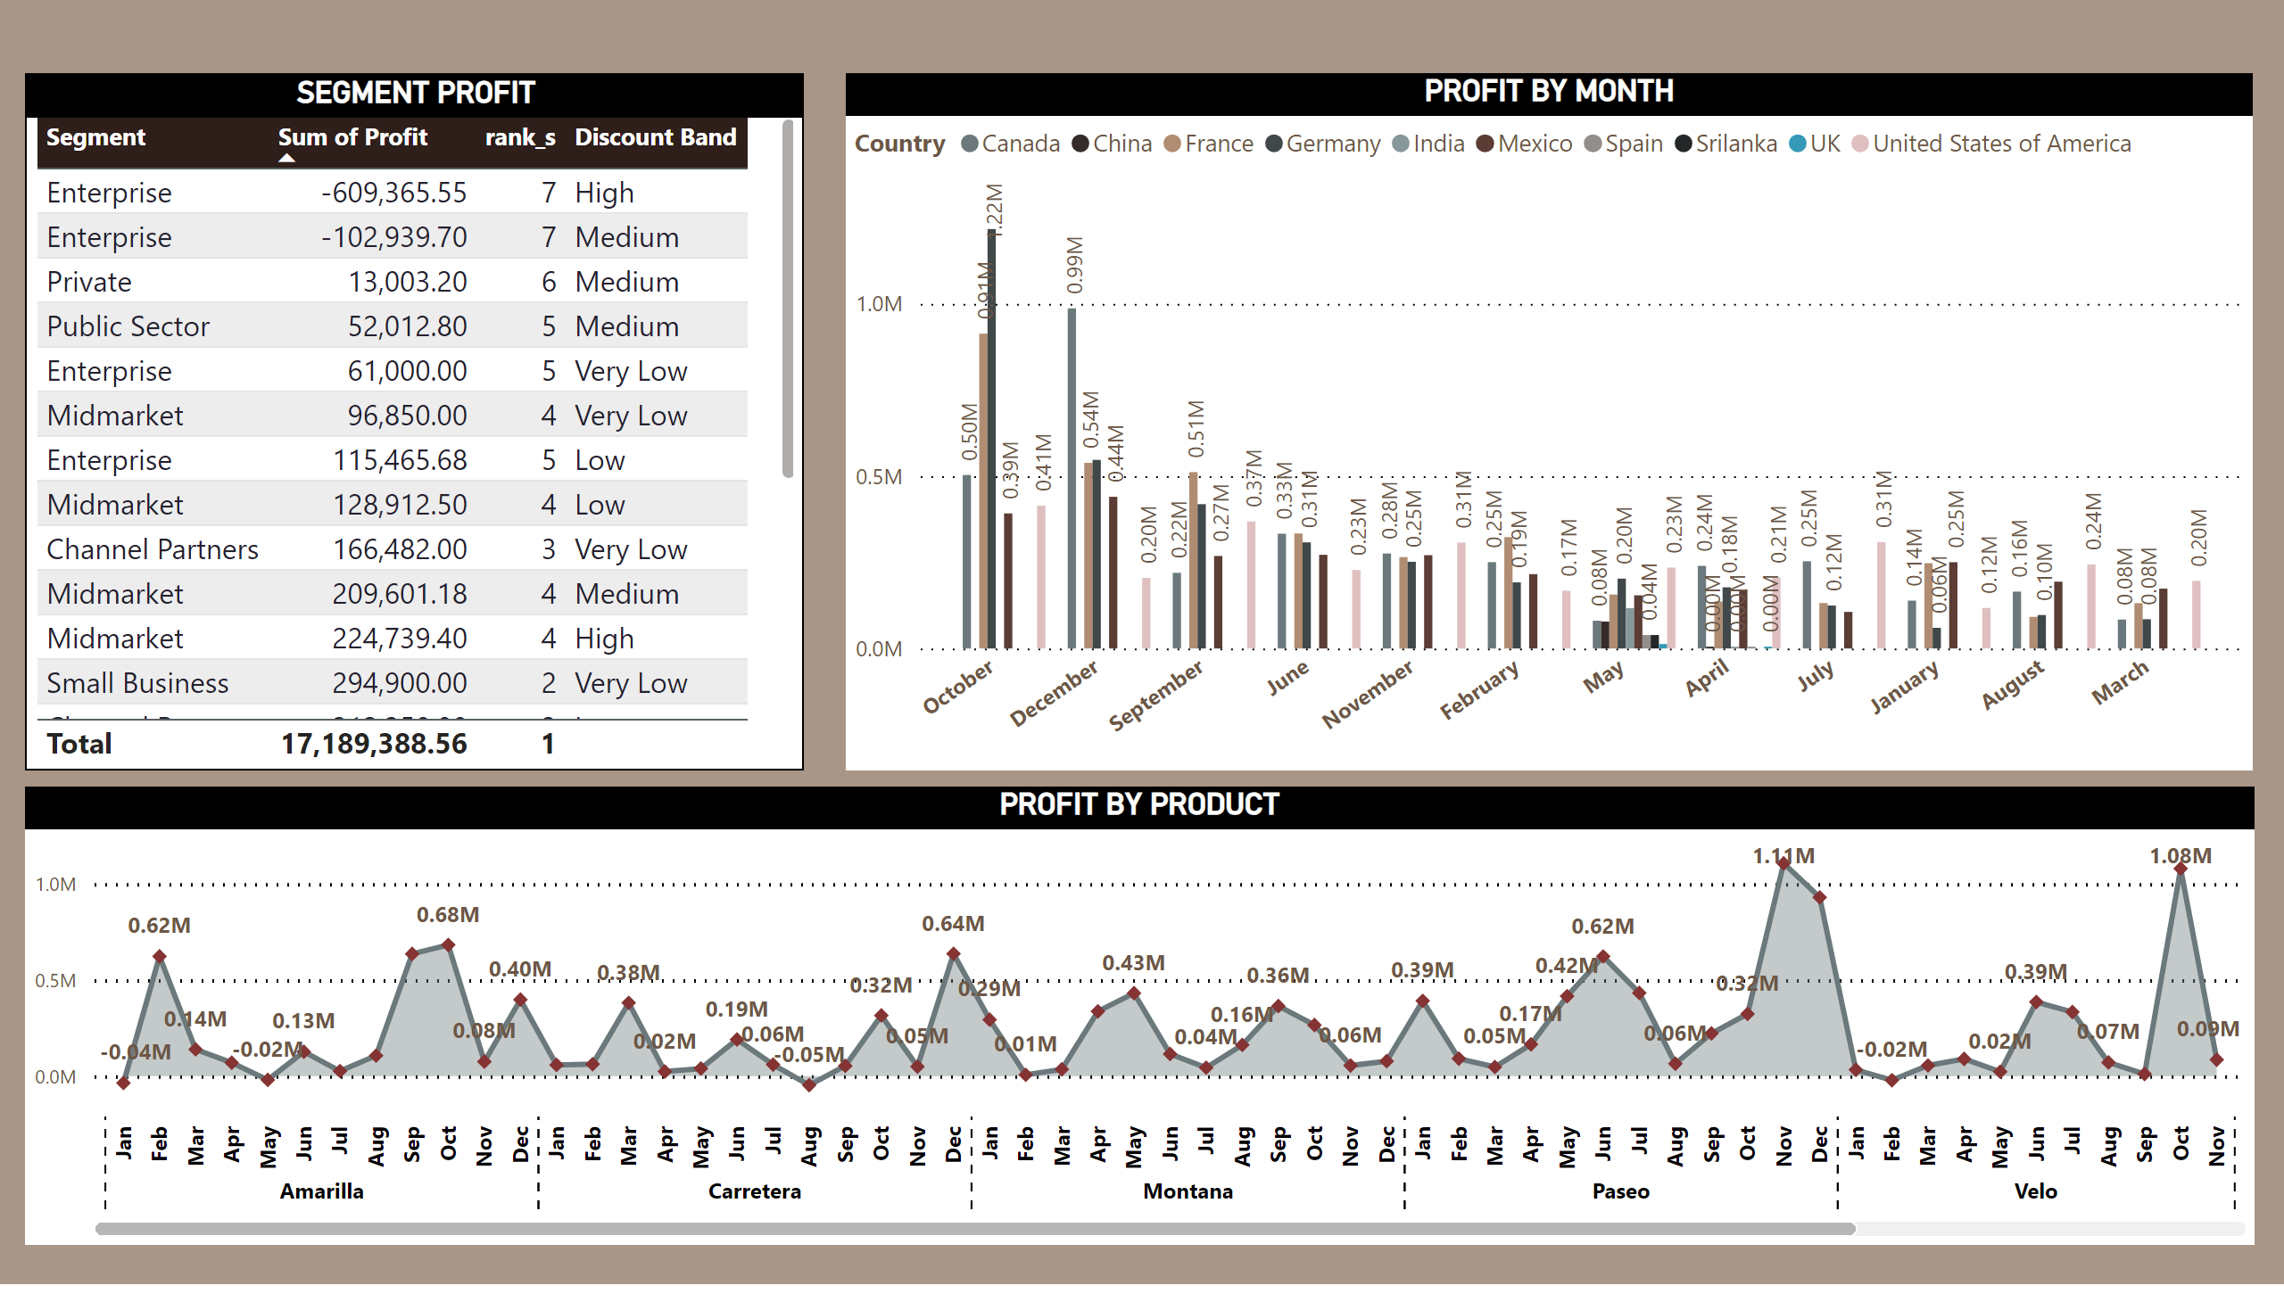
Page 5
Notes:
SEGMENT PROFIT
No alt text provided
PROFIT BY PRODUCT
No alt text provided
PROFIT BY MONTH
No alt text provided

Slide 7
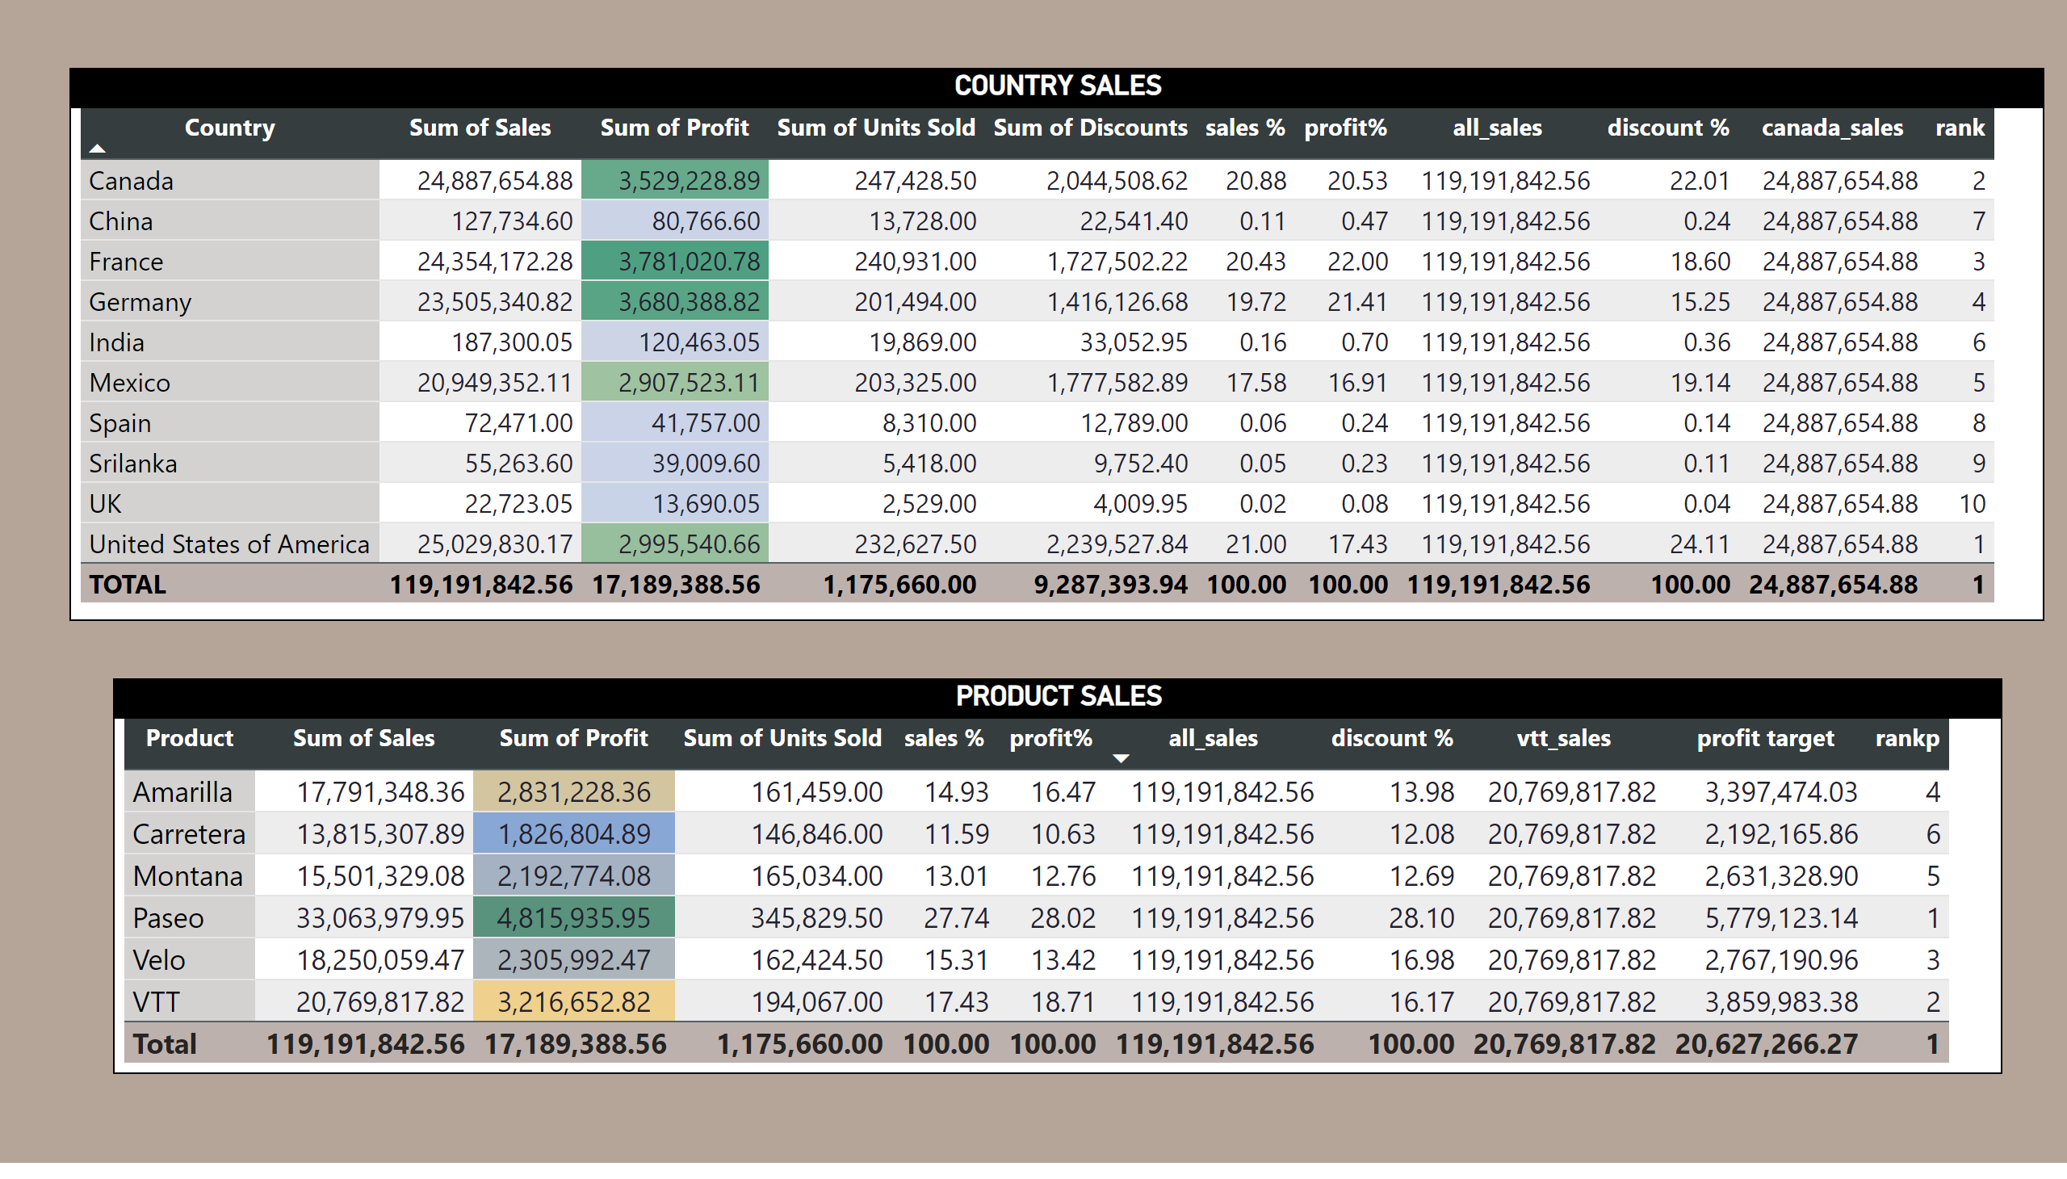
Page 6
Notes:
COUNTRY SALES
No alt text provided
PRODUCT SALES
No alt text provided

Slide 8
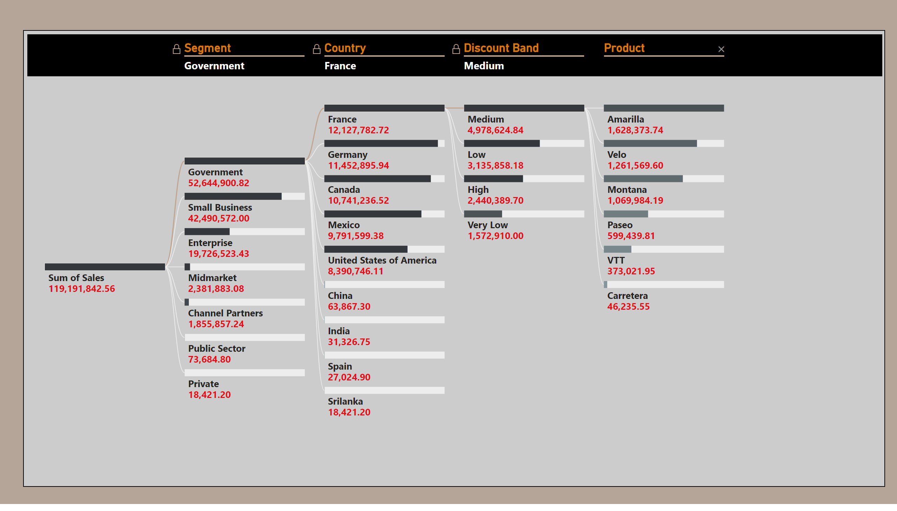
Page 7
Notes:
decompositionTreeVisual
No alt text provided

Slide 9
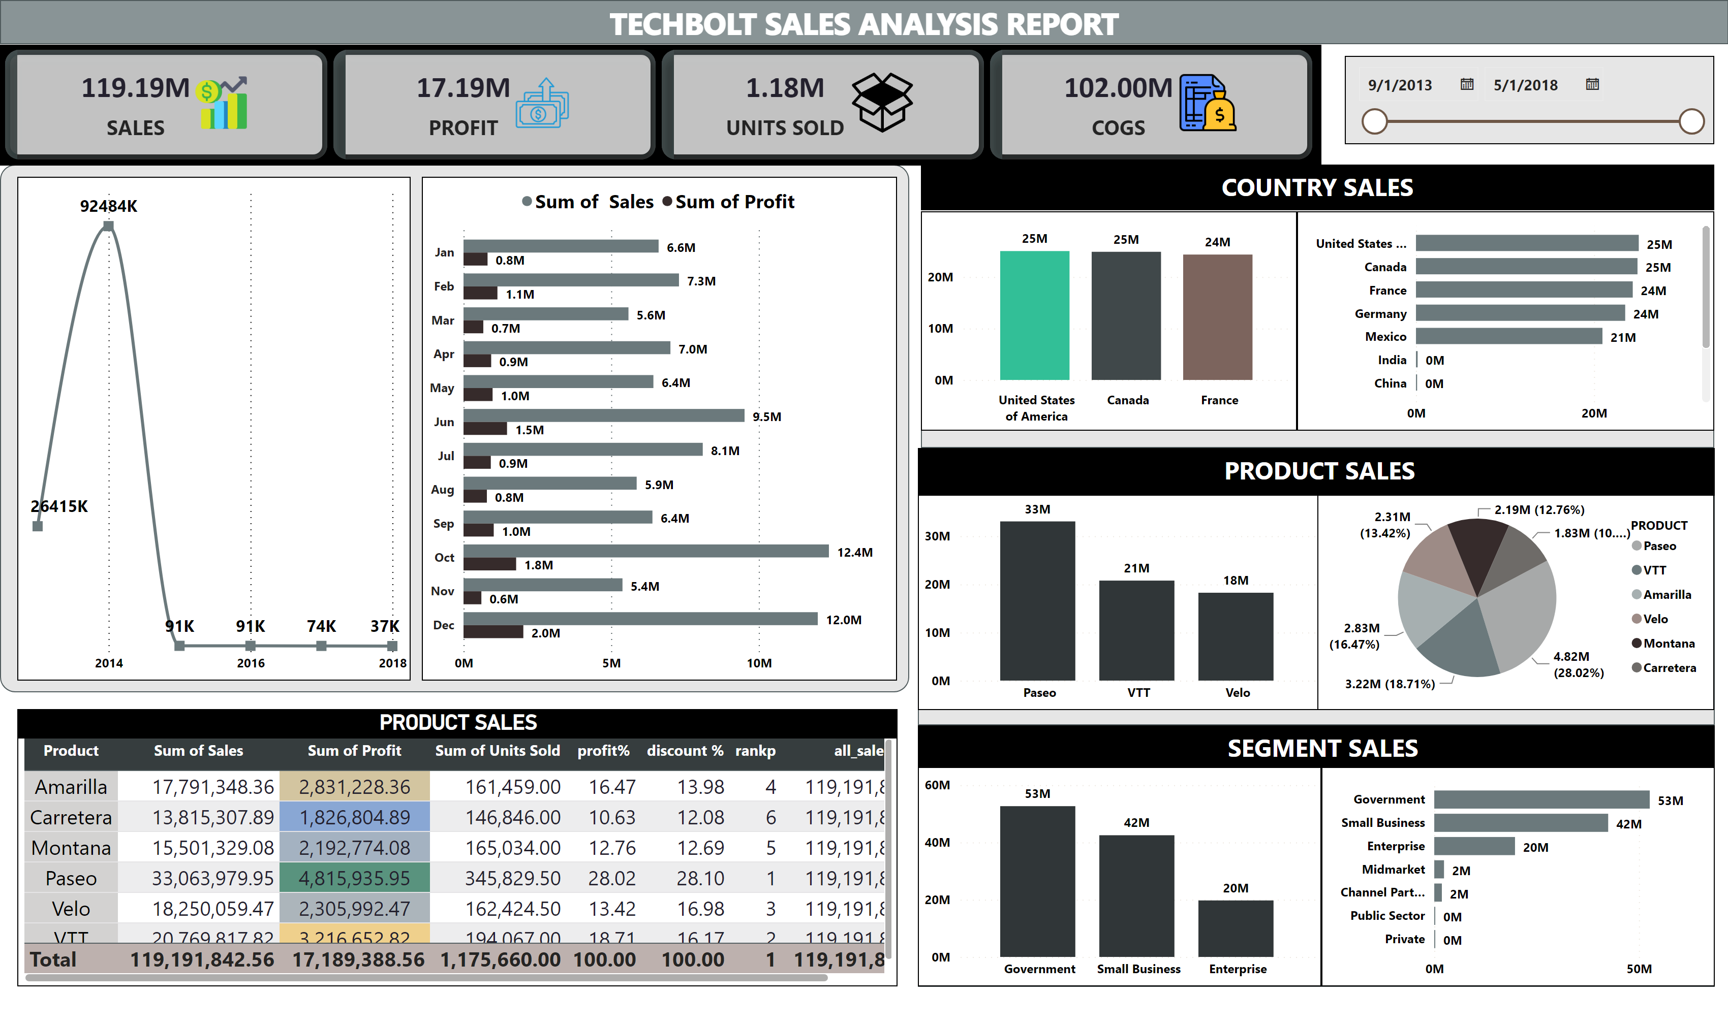
Page 8
Notes:
shape
No alt text provided
cardVisual
No alt text provided
SALES BY COUNTRY
No alt text provided
PRODUCT SALES
No alt text provided
PROFIT BY PRODUCT
No alt text provided
SALES BY MONTH
No alt text provided
TOP 3 PRODUCTS
No alt text provided
shape
No alt text provided
lineChart
No alt text provided
shape
No alt text provided
shape
No alt text provided
shape
No alt text provided
clusteredBarChart
No alt text provided
TOP 3 PRODUCTS
No alt text provided
clusteredBarChart
No alt text provided
DATE
No alt text provided
textbox
No alt text provided
textbox
No alt text provided
textbox
No alt text provided

